Slide 1
NETWORKING NEWSLETTER
Advancing Sustainable Rural Development: Principles And Best Practices For Effective Community Engagement
June 22, 2023
Here is where your presentation begins
DAMILOLA OLAJUBUTU
Founder & Executive Director,
Rural Nurture Initiative (RNI)
www.rnionline.org

Slide 2
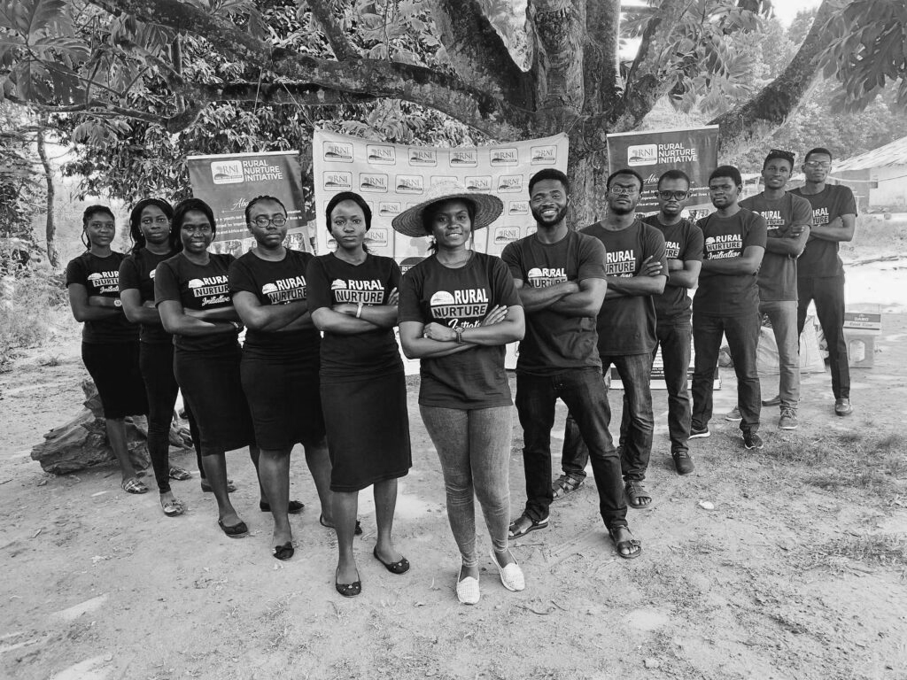
www.rnionline.org
OBJECTIVE:
To explore principles and best practices of effective community engagement towards promoting sustainable rural development
in Africa.

Slide 3
01
INTRODUCTION
www.rnionline.org

Slide 4
RURAL DEVELOPMENT
WHAT?
Rural development is the process of improving the quality of life and economic well-being of people in rural areas,
(World Bank, 2008)
WHY?
Poverty Reduction, Food Security, Social Equity, Economic Diversification, Community Empowerment, and Sustainability.
www.rnionline.org

Slide 5
KEY COMPONENTS OF RURAL DEVELOPMENT
Economic growth through enhanced agricultural productivity and diversification.
Infrastructure development, including transportation, electricity, and sanitation.
Expansion of social services like education and health care.
Participatory approaches that involve local communities in decision-making.
Sustainability to protect natural resources and enhance resilience.
(Chambers, 1983; World Bank, 2008; FAO, 2017)
www.rnionline.org

Slide 6
COMMUNITY ENGAGEMENT PROCESS
COLLABORATIVE ACTION PLAN
COMMUNITY EMPOWERMENT
IMPLEMENT WITH SUPPORT
FEEDBACK & MONITORING
Co-create an action plan that outlines roles, timelines, and responsibilities for all stakeholders
Establish feedback channels to gather community input and monitor progress
EVALUATE & CELEBRATE
Execute activities with ongoing community involvement and support
Assess outcomes together, reflect on lessons learned, and celebrate milestones to boost motivation.
www.rnionline.org

Slide 7
COMMUNITY ENGAGEMENT
WHAT?
WHY?
WHY?
WHY?
Ensures that development projects are tailored to the community’s needs
Empowers communities to take ownership, increasing sustainability
A process that actively involves individuals, groups, and organizations in meaningful participation toward shared objectives within their communities (Centers for Disease Control and Prevention, 2011)
WHY?
Builds trust and collaboration between local actors
Reduces resistance and enhances participation, leading to more impactful outcomes
www.rnionline.org

Slide 8
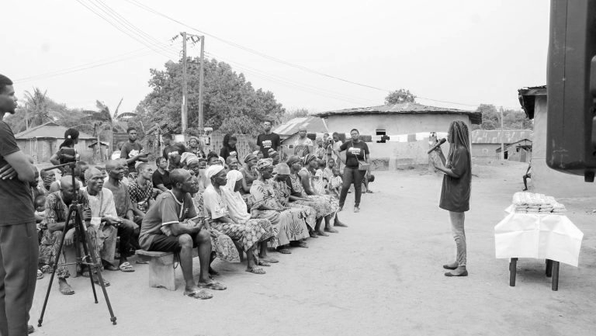
www.rnionline.org
COMMUNITY ENGAGEMENT IN RD
In the rural development context, community engagement ensures that interventions are grounded in local knowledge and addresses the unique social, economic, and cultural dynamics of rural settings (Wilkinson, 1991).

Slide 9
02
PRINCIPLES

Slide 10
PRINCIPLES OF COMMUNITY ENGAGEMENT (CTSAC, 2011)
01
02
03
INCLUSIVITY
TRANSPARENCY
CULTURAL SENSITIVITY
04
05
RECIPROCITY
PARTICIPATORY DECISION-MAKING
Ensure representation of all groups, especially marginalized voices (e.g., women, youth, people with disabilities).
Maintain open communication about goals, processes, and progress to build trust and align expectations
Respect and integrate local traditions, norms, and values in development approaches
Build mutually beneficial relationships in which both the community and the organization gain value from the engagement process
Allow community members to co-create and contribute to decision-making, promoting shared ownership.
www.rnionline.org

Slide 11
06
07
08
FLEXIBILITY
SUSTAINABILITY FOCUS
EVALUATION
PRINCIPLES OF COMMUNITY ENGAGEMENT (CTSAC, 2011)
Remain adaptable and responsive to evolving community needs, challenges, and feedback
Engage with a long-term perspective, ensuring that community involvement continues beyond initial interventions
Continuously assess the effectiveness of engagement efforts, gathering feedback to make improvements
www.rnionline.org

Slide 12
LEVELS OF COMMUNITY INVOLVEMENT
Provide the community with information to help them understand issues, alternatives, and potential solutions. This level is generally one-way communication
Place final decision-making in the hands of the community. The community has significant control, often leading to shared ownership and responsibility for the project's success
Work directly with the community throughout the process to ensure concerns and aspirations are consistently understood and considered
1
3
5
INFORM
INVOLVE
EMPOWER
2
4
CONSULT
COLLABORATE
?
Obtain public feedback on analysis, alternatives and/or decisions.
Partner with the community in each aspect of decision-making, including developing alternatives and identifying preferred solutions. At this level, community input has a more substantial impact on outcomes
?
?
Source: IAP2 (2018)
Where is your
organization
www.rnionline.org

Slide 13
03
PROCESS

Slide 14
COMMUNITY ENGAGEMENT PROCESS FOR SUSTAINABLE RURAL DEVELOPMENT
Agency
Ownership
Sustainability
Community Entry
Community mobilization
Community Empowerment
Adapted from Simpson and Omaleki (2019)
www.rnionline.org

Slide 15
ESTABLISHING RELATIONSHIP
LEGITIMIZATION
COMMUNITY ENTRY
SITUATION ANALYSIS
COMMUNITY ENGAGEMENT PROCESS
Respectfully engage with the community to understand its dynamics and establish rapport
Gain support from local leaders to enhance credibility and foster trust.
Assess the community’s context, challenges, and opportunities to inform engagement
www.rnionline.org

Slide 16
COMMUNITY ENGAGEMENT PROCESS
DEFINE OBJECTIVES
BUILD TRUST
COMMUNITY MOBILIZATION
IDENTIFY STAKEHOLDERS
SELECT SUITABLE METHODS
Clearly outline project goals that align with community needs and aspirations
Choose culturally appropriate and accessible engagement methods
Socialize, act with integrity and respect cultural customs to foster strong relationships
PARTICIPATORY NEEDS ASSESSMENT
Map out and include all relevant stakeholders, emphasizing marginalized groups
Collaborate with the community to identify key issues and priorities
www.rnionline.org

Slide 17
COMMUNITY ENGAGEMENT PROCESS
COLLABORATIVE ACTION PLAN
COMMUNITY EMPOWERMENT
IMPLEMENT WITH SUPPORT
FEEDBACK & MONITORING
Co-create an action plan that outlines roles, timelines, and responsibilities for all stakeholders
Establish feedback channels to gather community input and monitor progress
EVALUATE & CELEBRATE
Execute activities with ongoing community involvement and support
Assess outcomes together, reflect on lessons learned, and celebrate milestones to boost motivation.
www.rnionline.org

Slide 18
04
BEST PRACTICES

Slide 19
BEST PRACTICES IN COMMUNITY ENGAGEMENT FOR RURAL DEVELOPMENT
EARLY AND ONGOING CONSULTATION
LOCAL KNOWLEDGE INTEGRATION
BUILDING LOCAL CAPACITY
Engage communities from the planning stages and maintain open dialogue throughout the project cycle
Incorporate indigenous knowledge systems and local expertise in development interventions
Invest in training and knowledge transfer to enable communities to continue development efforts independently.
www.rnionline.org

Slide 20
BEST PRACTICES IN COMMUNITY ENGAGEMENT FOR RURAL DEVELOPMENT
COLLABORATIVE PARTNERSHIPS
ACKNOWLEDGING COMMUNITY EFFORTS
FEEDBACK MECHANISMS
Foster collaboration between community members, NGOs, local governments, and other stakeholders
Recognize and celebrate milestones and achievements within the community to foster motivation, reinforce engagement, and build a sense of ownership.
Establish clear channels for continuous feedback and adaptation of projects based on community input
www.rnionline.org

Slide 21
KEY LEADERSHIP SKILLS FOR EFFECTIVE COMMUNITY ENGAGEMENT
01
02
03
COMMUNICATION
EMPATHY
FLEXIBILITY
04
05
CONFLICT RESOLUTION
PATIENCE AND PERSISTENCE
Ability to clearly articulate ideas and facilitate dialogue
Understanding and respecting diverse community perspectives
Adapting strategies to meet evolving community needs
Managing disputes and promoting consensus
Staying committed to long-term goals despite setbacks
www.rnionline.org

Slide 22
05
CASE STUDIES

Slide 23
CASE STUDIES OF EFFECTIVE COMMUNITY ENGAGEMENT IN RURAL DEVELOPMENT
RURAL NURTURE INITIATIVE’S SAFE RURAL WATER PROJECT IN NIGERIA
www.rnionline.org
Clean water access and better hygiene at Agele village, Ibarapa LGA, Oyo State.
THE PARTICIPATORY FOREST MANAGEMENT PROJECT IN TANZANIA
Livelihoods enhancement and forest resources conservation; implemented by Tanzania's Ministry of Natural Resources and Tourism and other partners (Wily, 2002).
FAO’S FARMER FIELD SCHOOLS IN UGANDA
Experiential learning for enhanced agricultural productivity and sustainability (FAO, 2015).

Slide 24
CASE STUDIES OF EFFECTIVE COMMUNITY ENGAGEMENT IN RURAL DEVELOPMENT
THE PARTICIPATORY VIDEO PROJECT IN KENYA
www.rnionline.org
Rural community empowerment for engagement and advocacy (Tufte & Mefalopulos, 2009).
THE "COMMUNITY-LED DEVELOPMENT" INITIATIVE IN MALAWI
Community empowerment to identify and implement their own development projects; implemented by the Malawi Ministry of Local Government (Kambewa & Mchenga, 2015).
THE "CLEAN COOKSTOVES" PROJECT IN GHANA
Improved health and environmental conditions; (Ghana Ministry of Environment, Science, Technology, and Innovation, 2014).

Slide 25
06
CHALLENGES

Slide 26
CHALLENGES IN CONDUCTING COMMUNITY ENGAGEMENT
POTENTIAL BARRIERS
Cultural differences or misunderstandings.
Power dynamics within communities.
Limited resources or logistical challenges.
Resistance to change or external intervention.
MITIGATION STRATEGIES
Adaptation to local contexts.
Strong facilitation & mediation to address power imbalances.
Capacity building and local resource utilization
Securing buy-in from key community leaders.
www.rnionline.org

Slide 27
07
CONCLUSION

Slide 28
CONCLUSION
Call to Action!!!
Community engagement is fundamental to sustainable rural development, creating shared ownership and accountability.
Applying principles such as inclusivity, transparency, and participatory decision-making fosters trust and enhances project outcomes.
Leadership, continuous feedback, and strong partnerships play a vital role in building resilient, self-sustaining communities.
Addressing challenges proactively—like resource limitations and cultural differences—ensures more adaptable and responsive community engagement efforts.
ACTIVE ENGAGEMENT + CONTINUOUS LEARNING
www.rnionline.org

Slide 29
QUESTION & DISCUSSIONS
www.rnionline.org

Slide 30
REFERENCES
Centers for Disease Control and Prevention. (2011). Principles of community engagement (2nd ed.). CDC/ATSDR Committee on Community Engagement.
Chambers, R. (1983). Rural Development: Putting the Last First. London: Longman.
Clinical and Translational Science Awards Consortium, CTSAC. (2011). *Principles of Community Engagement* (2nd ed.). Washington, DC: National Institutes of Health.
FAO. (2015). The Farmer Field School: A Manual for Farmers.
FAO. (2017). The State of Food and Agriculture: Leveraging Food Systems for Inclusive Rural Transformation. Rome: Food and Agriculture Organization.
Ghana Ministry of Environment, Science, Technology, and Innovation. (2014). "Clean Cookstoves Initiative: Progress Report.
IAP2 (2018). IAP2 Spectrum of Public Participation. International Association for Public Participation. Available at: https://cdn.ymaws.com/www.iap2.org/resource/resmgr/pillars/Spectrum_8.5x11_Print.pdf
Kambewa, P., & Mchenga, N. (2015). "Community-Led Development in Malawi: Success Stories." Malawi Ministry of Local Government
Simpson, J. and Omaleki, V. (2019). Community Entry Best Practices at Project Concern International: Experiences from Implementing Staff. Available at https://globalcommunities.org/wp-content/uploads/2021/11/PCI-Community-Entry-White-Paper-Final-May-31-2019.pdf
Tufte, T., & Mefalopulos, P. (2009). "Participatory Communication: A Practical Guide." World Bank.
Wilkinson, K. P. (1991). The community in rural America. Greenwood Press.
Wily, L. A. (2002). "Participatory Forest Management in Africa: An Overview of the Evidence." FAO Regional Office for Africa.
World Bank. (2008). World Development Report 2008: Agriculture for Development. Washington, DC: World Bank Publications.

Slide 31
CONTACT
damilola.olajubutu@rnionline.org info@rnionline.org
+234 810 075 7635
www.rnionline.org
Rural Nurture Initiative

